Slide 1




MELTTS
AI MEETING SUMMARIZER
“Automating Meeting Transcription, Diarization, and Summarization”
PRESENTED BY
Sonal Verma

Slide 2


MELTTS
Motivation
Modern meetings generate *hours of audio*, hard to review manually.
Need for *automated summarization* to improve productivity.
Challenges:
Long recordings
Multiple speakers
Background noise
Extracting key insights efficiently

Slide 3



MELTTS
Project Overview
1
5
Generates AI summaries
Cleans audio
2
Transcribes speech
6
Supports real-time or uploaded audio
3
Identifies speakers
7
Provides both CLI and Streamlit dashboard
4
Merges results

Slide 4

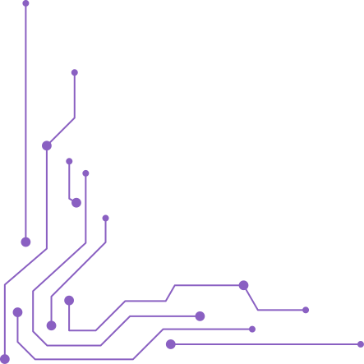
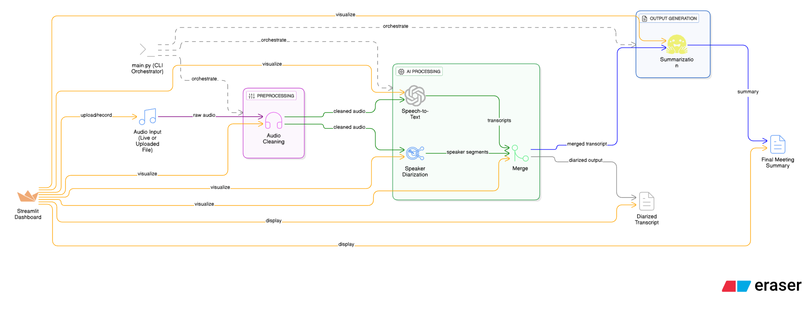
MELTTS
System Architecture

Slide 5
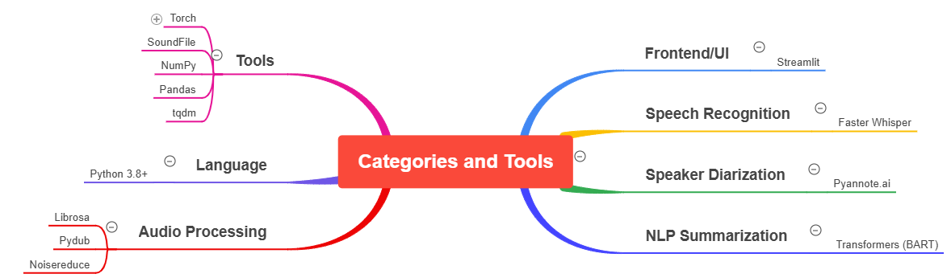
MELTTS
Tech Stack

Slide 6

MELTTS
Pipeline Stages (Detailed Flow)
STEP | DESCRIPTION | SCRIPT/MODULE
1. Audio Cleaning | Noise reduction, resampling | milestone_1/audio_cleaner.py
2. Transcription | Faster Whisper model | milestone_2/usingfilemodel.py
3. Diarization | Speaker detection via Pyannote | milestone_4/dairization.py
4. Merging | Align speech & speakers | milestone_4/merge.py
5. Summarization | Transformer (BART) | milestone_4/summarizer.py

Slide 7
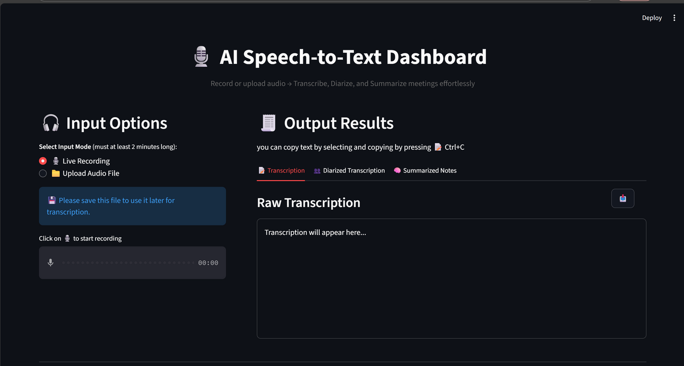
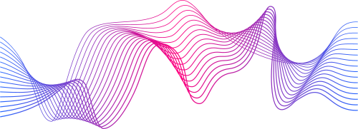
MELTTS
User Interface (Dashboard)
Built with Streamlit
Allows:
Uploading or recording audio
Running full pipeline
Viewing transcript, diarization, and summary

Slide 8
MELTTS
Core AI Models
1. Whisper (Speech-to-Text)
Model: faster-whisper/small.en
Converts speech → text with timestamps
2. Pyannote.ai (Diarization)
Identifies who spoke when
Cloud-based API
3. BART (Summarization)
Model: facebook/bart-large-cnn
Converts long transcripts into concise summaries

Slide 9
MELTTS
Evaluation & Testing
WER (Word Error Rate):
measured using jiwer
Quality checks:
Clean waveform (manual)
Transcript accuracy
Speaker correctness
Summary coherence
Independent testing of each milestone (modular design)

Slide 10

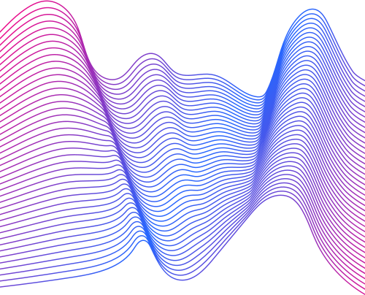
MELTTS
Key Features & Highlights
Real-time and file-based audio support
Accurate transcription with Whisper
Multi-speaker diarization
Summarization using Transformer models
Modular design — each milestone testable
Interactive Streamlit dashboard

Slide 11





MELTTS
Future Enhancements & Conclusion
Future Work::
Live meeting integration (Zoom, MS Teams APIs)
Real-time diarization
Multi-language support
Sentiment and action item detection
Conclusion::
“AI Meeting Summarizer reduces hours of meeting analysis to minutes — enabling smarter collaboration and faster decision-making.”

Slide 12

Thank You

